Slide 1
Web Services
Foundations of Programming:

Slide 2
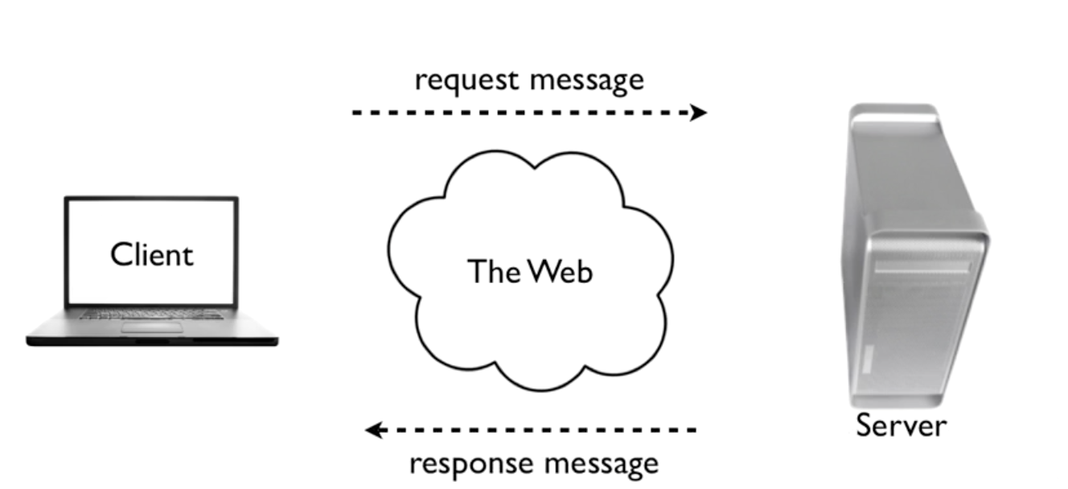
What is a web service?
A framework for a conversation between two computers.

Slide 3
What is an api?
Application Programming Interface
Defines everything you need to communicate with a web service

Slide 4
Elements of a Web Service API
Message format : SOAP, XML, JSON, other
Request syntax
Named method
Uniform Resource Identifier (UPI)
Parameter names and data types

Slide 5
Elements of a Web Service API
Requesting an action
Named method
HTTP verbs (POST, GET, PUT, PATCH, DELETE)
Authentication
Username and password
Authentication tokens

Slide 6
Elements of a Web Service API
Receiving the data
Formats : SOAP, XML, JSON
Metadata: describes data structure, including field/ property names and data types
Content : the actual data

Slide 7
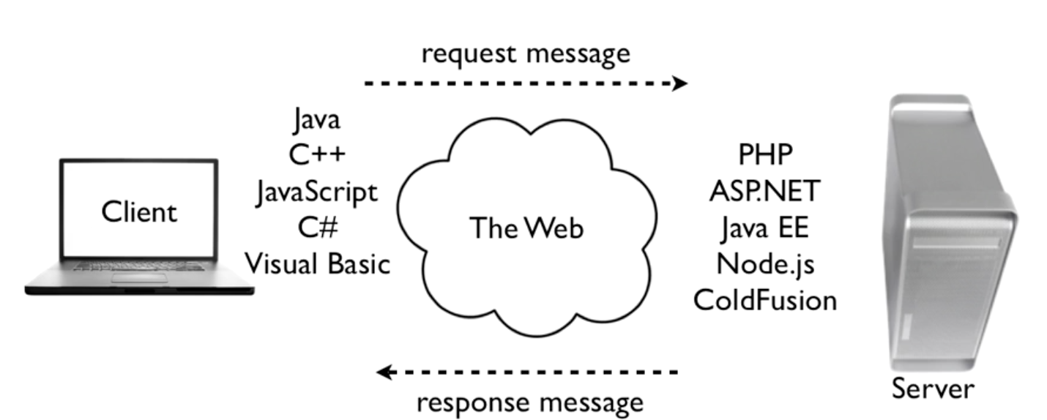
Client and Server Languages

Slide 8
Where did the term “web service” come from?
Web Service Predecessors
EDI (Electronic Data Interchange)
RPC (Remote Procedure Call)
MSRPC
CORBA (Common Object Request Broker Architecture)
Beyond CORBA
1998: Introducing XML (Extensible Markup Language)
The Web Service Revolution: SOAP, JSON,

Slide 9
Transport Protocols
Non-HTTP Transfer Protocol
HTTP (HyperText Transfer Protocol)

Slide 10
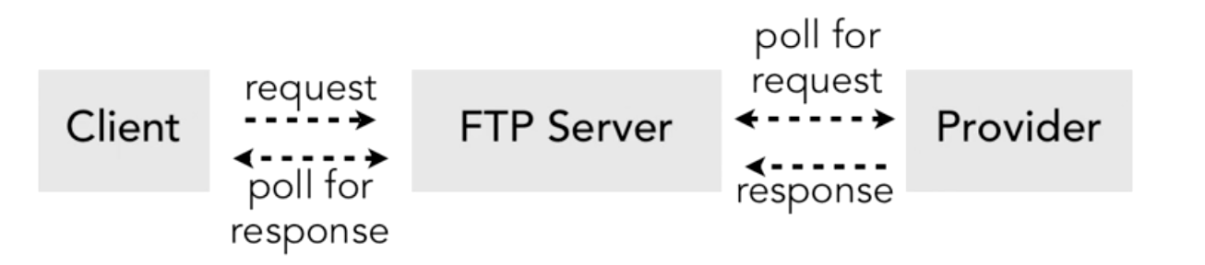
Non-HTTP Transport Protocols
File Transfer Protocol (FTP)
Well-suited for long documents
Commonly used for file sharing, but can also work with asynchronous web services

Slide 11
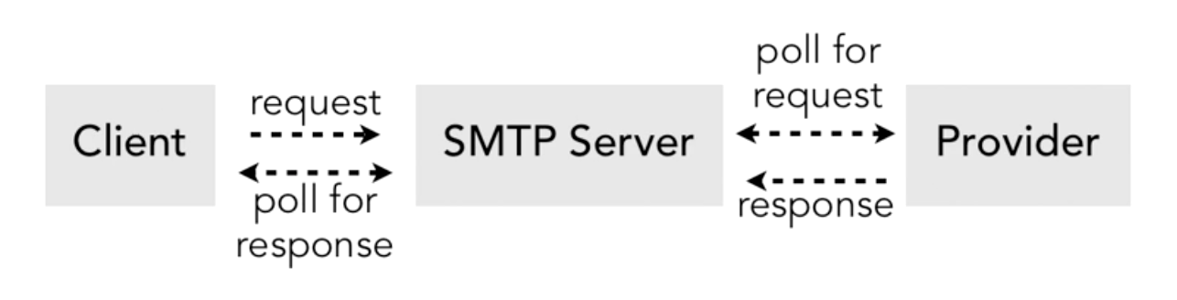
Non-HTTP Transport Protocols
Simple Mail Transfer Protocol (SMTP) and Post Office Protocol (POP)
Document storage is on a central hub server

Slide 12
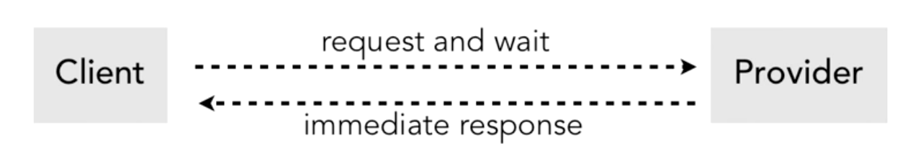
HyperText Transport Protocols (HTTP)
Text-based vocabulary defining requests and responses
Document storage usually on the web service provider
Support synchronous request/response conversations

Slide 13
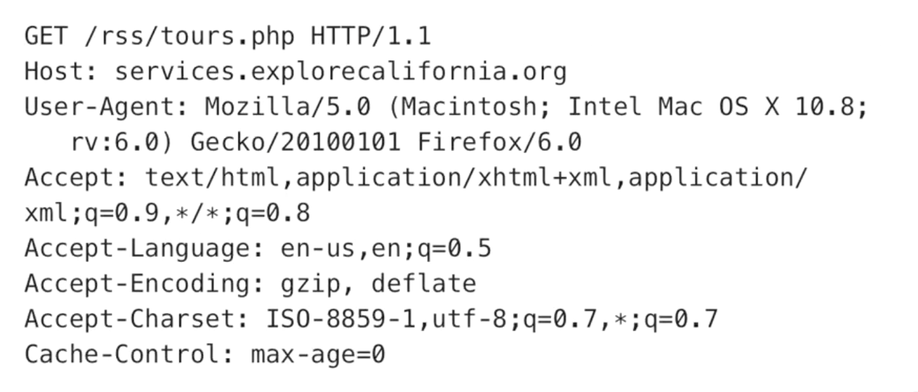
HTTP request syntax

Slide 14
HTTP request Methods
Most popular verbs used in web services
GET - get data
POST - add data
PUT - update
DELETE - delete data
PATCH and MERGE also in use

Slide 15
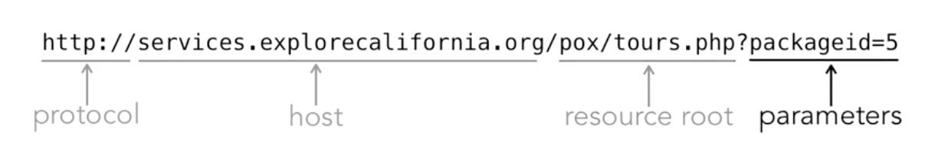
GET Requests
GET requests include query parameters in the URI

Slide 16
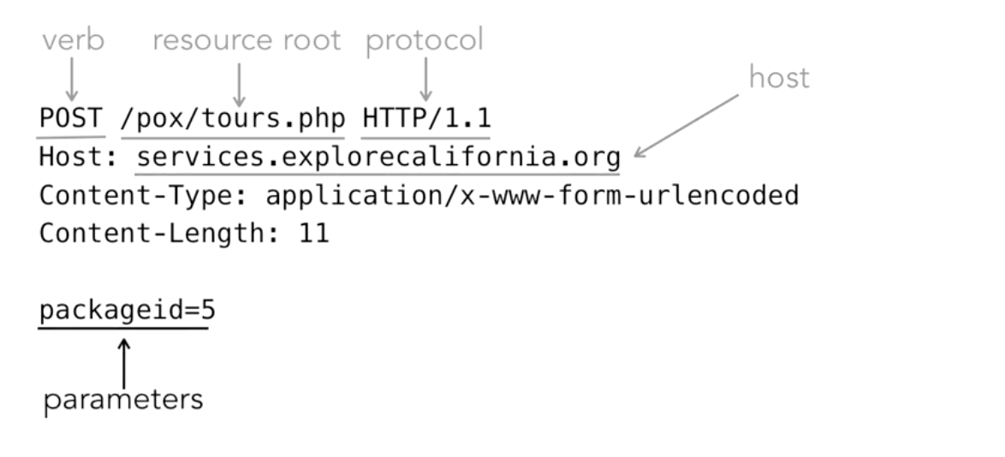
POST Requests syntax

Slide 17
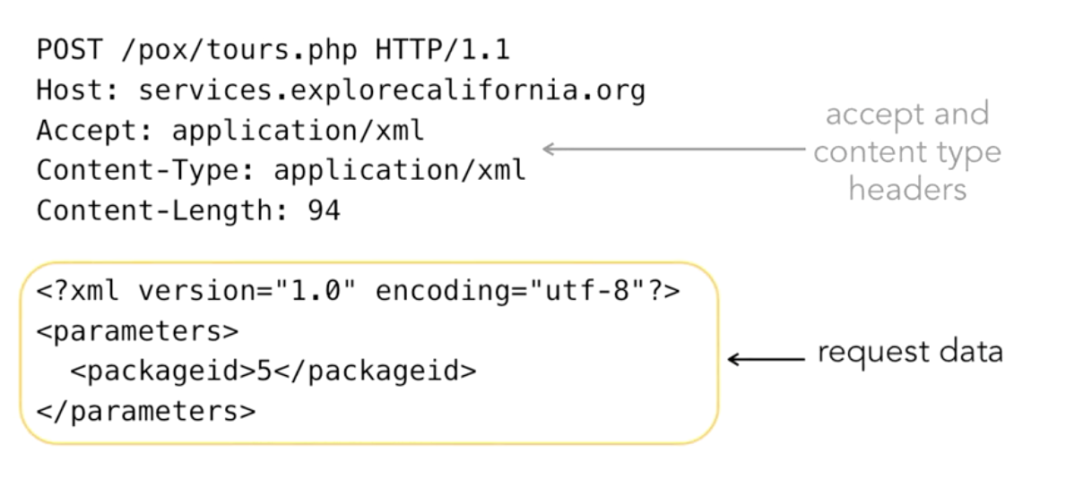
POST Requests syntax with XML

Slide 18
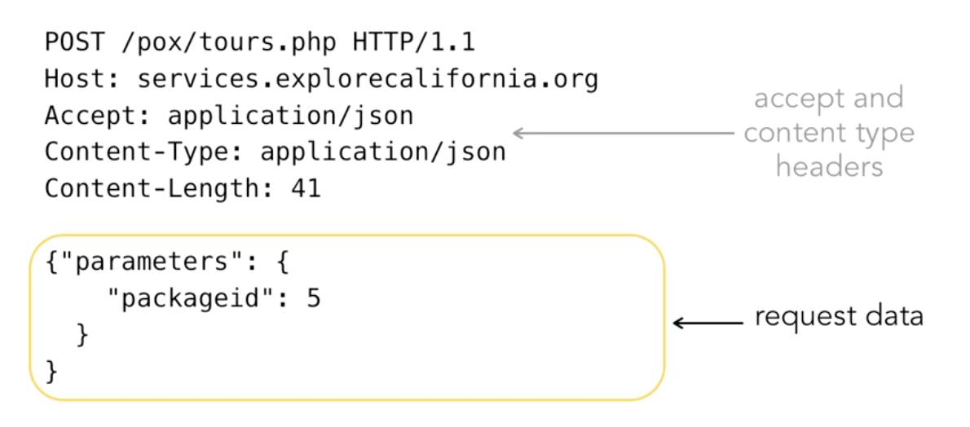
POST Requests syntax with JSON

Slide 19
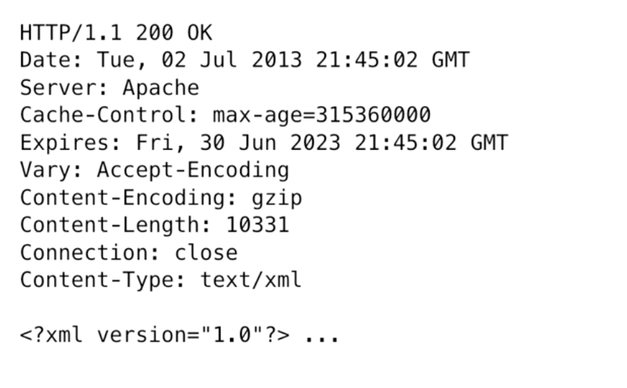
HTTP response syntax

Slide 20
Message formats
XML
JSON
HTML
binary format

Slide 21
Web service standards
SOAP
REST
OData

Slide 22
SOAP
Foundation of WS-* standards
Originally championed by Microsoft
Managed by W3C since 2001
SOAP is the format; tools are the key

Slide 23
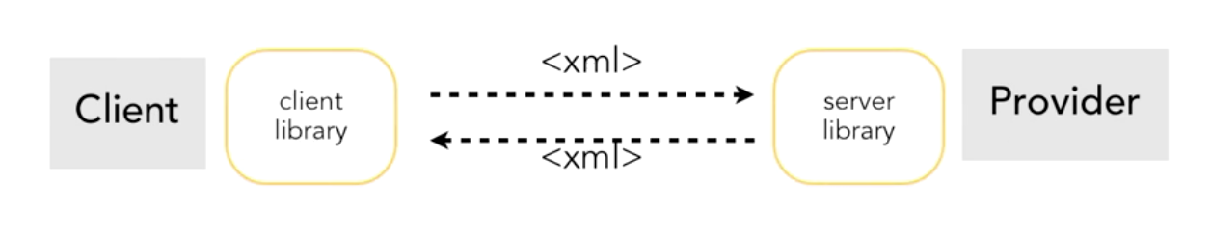
The role of SOAP toolkits

Slide 24
RESTful Web Services
Representational State Transfer
Coined by Roy Fielding
Based on simple HTTP requests and responses
Lighter-weight than SOAP
Each request has a verb: GET, POST, PUT, DELETE
Can be used with many message formats

Slide 25
RESTful Rules
Use any message format
Flavors of XML: ATOM, RSS or POX
Smaller, faster: JSON
Other constraints
Statelessness: each request is independent
Cacheable: results can be cached on client to reduce transactions

Slide 26
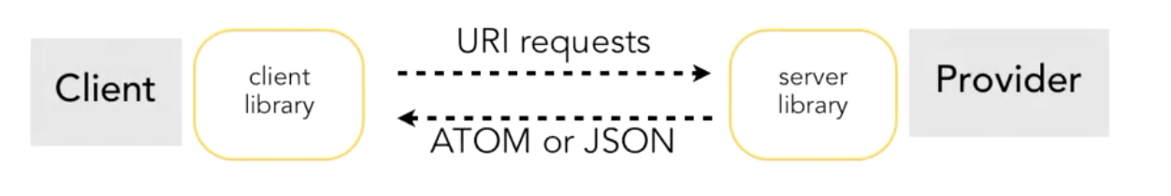
OData - a RESTful Standard
Based on REST architecture
Fixed message syntax
Choose between XML and JSON
OData libraries available for clients and servers

Slide 27
Other Web Service Standards
XML-RPC: XML Remote Procedure Call
UDDI: Universal Description Discovery and Integration
WSDL: Web Service Description Language
WSDM: Web Services Distributed Management
WS-*: All the others http://www.ws-i.org

Slide 28
UDDI
Universal Description Discovery and Integration
XML-based language to describe a service for registries
Developed in 2000 as part of WS-I
Designed around SOAP-based web services
Public registries created by Microsoft, SAP, IBM

Slide 29
UDDI
Universal Description Discovery and Integration
XML-based language to describe a service for registries
Developed in 2000 as part of WS-I
Designed around SOAP-based web services
Public registries created by Microsoft, SAP, IBM
http://www.xmethods.com/ve2/index.po
http://service-repository.com http://www.programmableweb.com

Slide 30
What is REST?

Slide 31
REST
Representational State Transfer
The style of software architecture behind RESTful services
Defined in 2000 by Roy Fielding
Primary goals
Scalability
Generality
Independent deployment of components

Slide 32
REST Request Messages
A RESTful request is typically in form of Uniform Resource Identifiers (URI)
Structure of URI depends on specific service
Requests can also include parameters in body of request as XML, JSON or other format

Slide 33
XML Response Messages
Popular XML-based formats
ATOM
RSS
Custom XML languages known as Plain Old XML (POX)

Slide 34
JSON Response
Newer web services return JSON
Less metadata
Smaller and faster

Slide 35
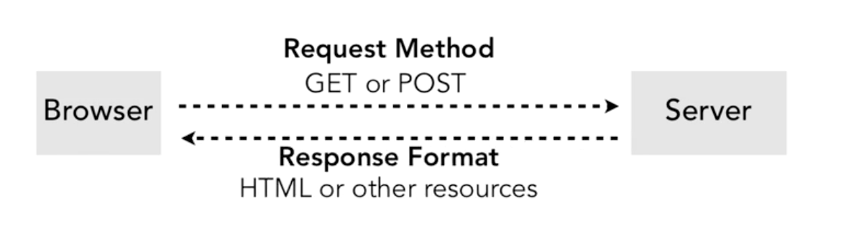
Browser Requests and Responses

Slide 36
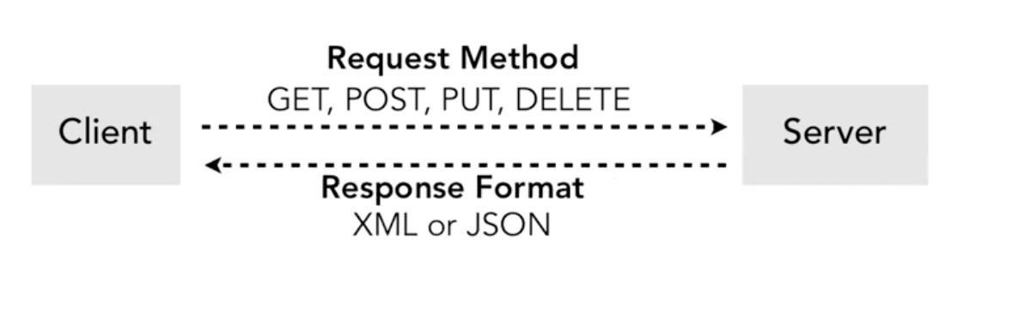
REST Requests and Responses

Slide 37
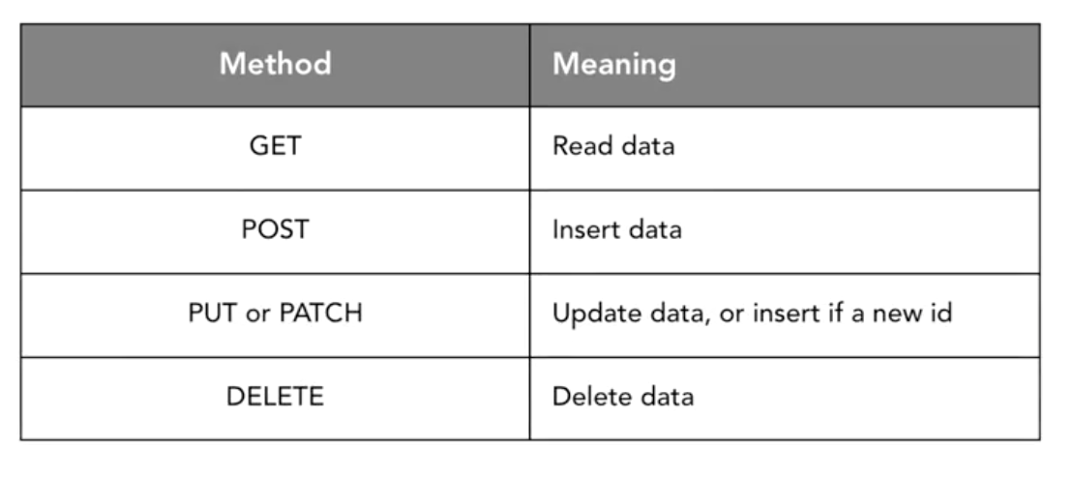
HTTP Methods and Their Meaning

Slide 38
HTTP Request Syntax
Request syntax and method are up to the service
Read-only services typically support GET and POST
Some expect URI-based requests with query parameters
Others handle embedded parameters

Slide 39
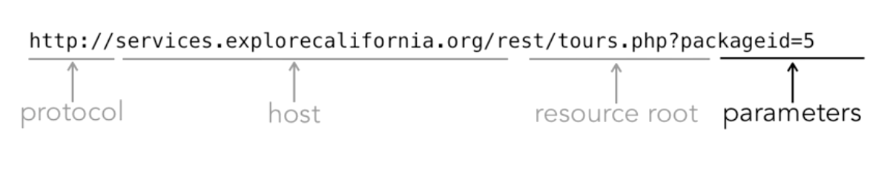
All Request Methods
GET requests include query parameters in the URI

Slide 40
POST Requests syntax with XML

Slide 41
Sending a Request
Client-side programming of requests differs based on language and platform
Most languages have built-in syntax
Many platforms have higher-level libraries that hide complexity and asynchronous request management

Slide 42
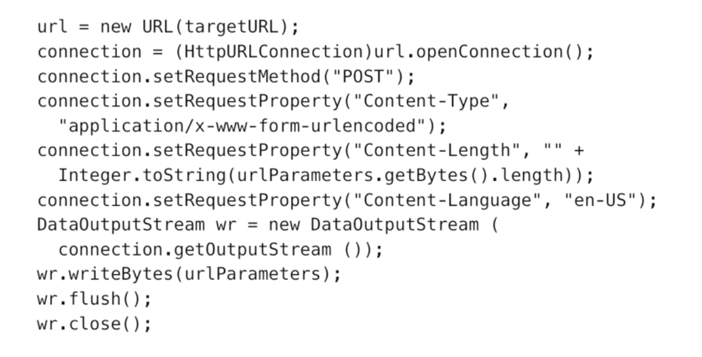
Java Raw HTTP Request

Slide 43
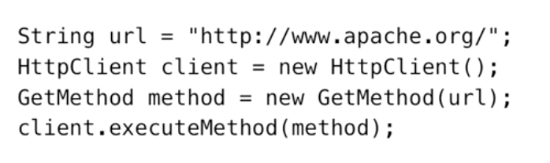
Apache HTTPClient Library
Code and documentation:
http://hc.apache.org/httpclient-3.x/

Slide 44
HTTP Libraries for Android
Volley
Newer HTTP library for Android from Google
Not much documentation, but easy to use
http://android.googlesource.com/platform/frameworks/volley/
OKHttp and Retrofit
Open source libraries from Square
http://square.github.io/okhttp/ http://square.github.io/retrofit/

Slide 45
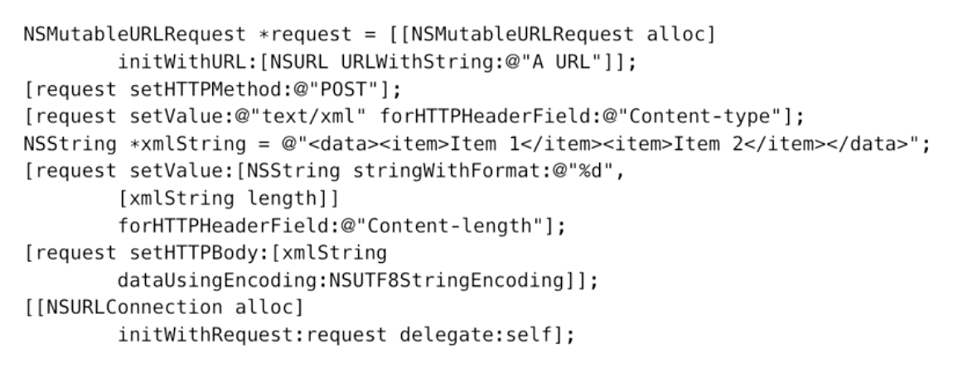
Objective-C POST Request

Slide 46
iOS and OSX Libraries
AFNetworking
http://afnetworking.com/
Resty
http://projects.lukeredpath.co.uk/resty/

Slide 47
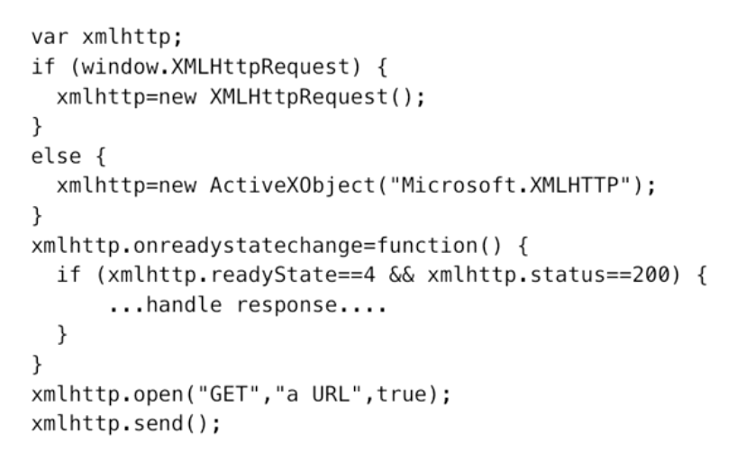
JavaScript XMLHttpRequest

Slide 48
JavaScript XMLHttpRequest

Slide 49
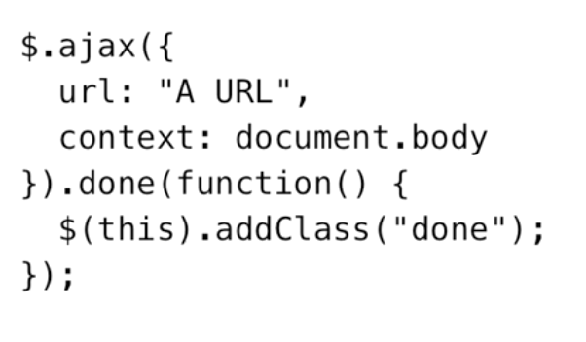
jQuery AJAX Request

Slide 50
RESTful Service Response Formats
Any format is acceptable, but ……
Most RESTful services work with XML or JSON

Slide 51
RESTful XML Formats
RSS
RSS 1.0: RDF Site Summary
RSS 2.0: Really Simple Syndication
Originally designed for web feeds
Can be used for other structured data
The standard for blog feeds (WordPress, others)

Slide 52
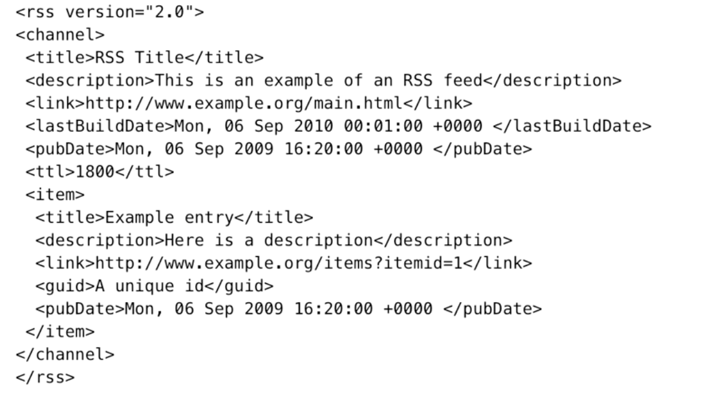
RSS 2.0 Example
http://services.explorecalifornia.org/rss/tours.php

Slide 53
RESTful XML Formats
ATOM Publishing Protocol
An HTTP-based protocol for managing web resources
ATOM Syndication Format
An XML language for web feeds and other structured data
Some advantages over RSS
Full spec at: http://www.ietf.org/rfc/rfc4287.txt

Slide 54
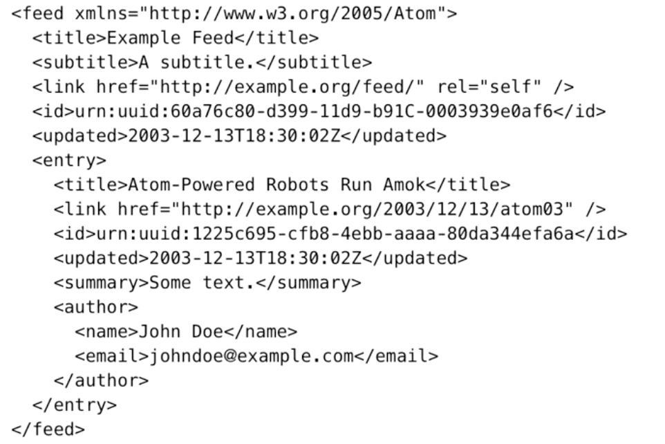
ATOM Example

Slide 55
RESTful XML Formats
Plain Old XML (POX)
Custom designed XML schemas
Commonly reflects underlying data structure
Some are standardized, others are service-specific

Slide 56
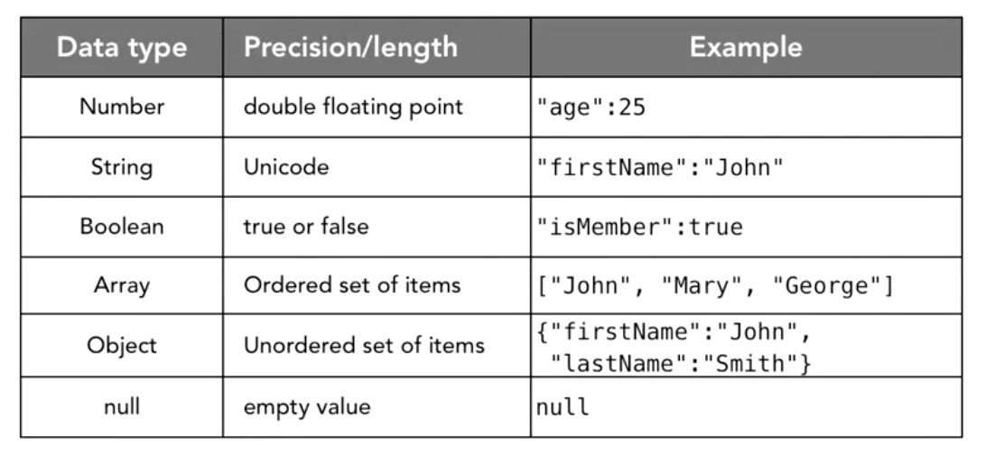
JSON Data Types

Slide 57
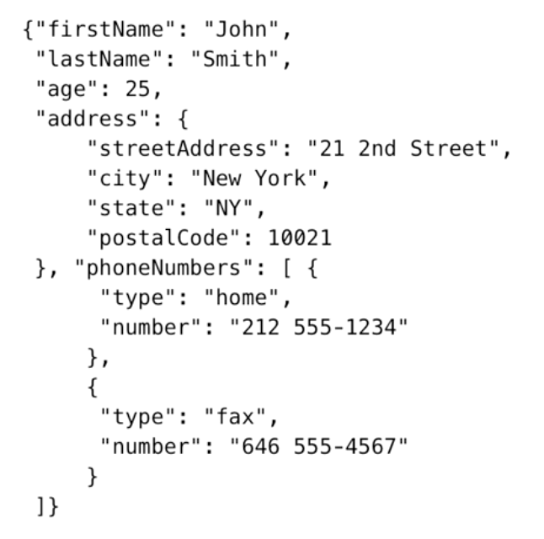
JSON Example

Slide 58
Creating a read-only web service in PHP
RSS : http://services.explorecalifornia.org/rss/tours.php
Plain old XML : http://services.explorecalifornia.org/pox/tours.php
JOSN : http://services.explorecalifornia.org/json/tours.php

Slide 59
OData: Open Data Protocol
A RESTful specification for web services
Requests are frequently URI-based with GET method
Other HTTP methods (POST, PUT, DELETE) acceptable
Responses can be ATOM (XML) or JSON

Slide 60
OData History
Created and championed by Microsoft
Deep support in Azure, Sharepoint, other MS products
Now open source
Implementations available for many platforms
http://www.odata.org/docs/

Slide 61
OData Conversations
Data model
Names of data collections
Names and data types of fields
Request format and transport protocol
URI’s have a specific format
HTTP verbs have a specific meaning
Client and server libraries: http://www.odata.org/libraries/

Slide 62
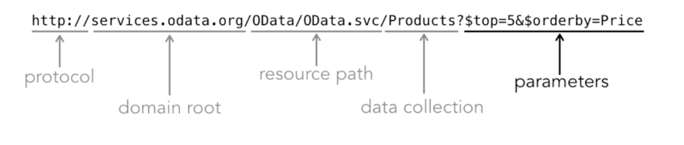
OData Requests
Typically in the form of a URI, including
Protocol
Domain root
Resource path
Query string parameters

Slide 63
System Query Options
Query option names are prefixed with $
$filter - add a data filter
$orderby - sorts data
$top - return a limited number of data items
REST Console + http://services.odata.org/OData/OData.svc/Products

Slide 64
Choosing a response format
$format=
json
atom

Slide 65
What is Encryption?
A cryptographic approach to protecting web-based traffic
HTTP requests and responses are mostly plain text
HTTP servers and clients can encrypt and decrypt messages

Slide 66
SSL
Secure Sockets Layer
A cryptographic protocol for encrypting and decrypting data over the web
Originally developed by Netscape
Supported by all modern HTTP servers and web clients

Slide 67
TLS
Transport Layer Security
Based on SSL; sometimes referred to as SSL/TLS
Fully supported by most HTTP servers and web client

Slide 68
HTTPS
Secure HTTP
HTTP within SSL/TLS
Establishes a secure bidirectional tunnel between client and server

Slide 69
Security certificates
Need to implement HTTPS on server
Available from trusted certificate authorities

Slide 70
Certificate Authorities
CAcert.org
Comodo
DigiCert
Entrust
GlobalSign
Symantec
http://maps.googleapis.com/maps/api/geocode/xml?address=1600+Amphitheatre+Parkway,+Mountain+View,+CA&sensor=false

Slide 71
Basic Security
Authenticates users based on username and password
In web pages, starts with a challenge dialog
In web service clients, credentials can be included with the initial request

Slide 72
Basic Security State Management
Requests are stateless
Cookies aren’t used to maintain state
Client can cache credentials for resubmission

Slide 73
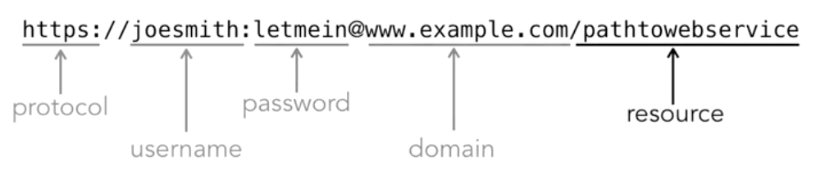
Basic Security in a URI
Requests are stateless
Cookies aren’t used to maintain state
Client can cache credentials for resubmission

Slide 74
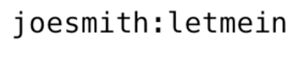
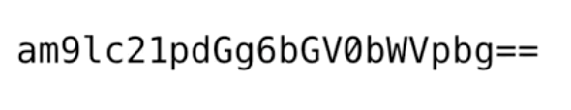
Basic Security in an HTTP Header
Concatenate name and password in a string
Encode in Base64
http://www.base64decode.org

Slide 75
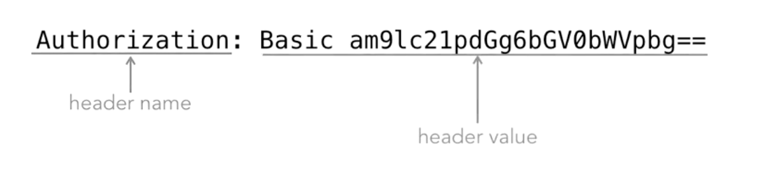
The Complete HTTP HEADER

Slide 76
Basic Security on the Server
Requests authenticated against a list of users
Databases, LDAP servers, Active Directory
For best security, stored passwords are encrypted
Passwords can be compared, but not easily decrypted

Slide 77
WS-Security
Web Services Security
An extension to SOAP to apply security to web services
A member of the WS-* family of web service standards
Specifies how integrity and confidentiality can be enforced
Allows communication of various security tokens
http://www.oasis-open.org/committees/tc_home.php?

Slide 78
OAuth
An open protocol for secure authorization
Used frequently in web, desktop and mobile environments
Used by Amazon, Google, PayPal, many others
http://oauth.net/

Slide 79
OpenID
An open protocol for secure authorization
Designed to allow login to multi web sites with a single ID
Used more commonly for web sites, but can be used for web services
http://openid.net/

Slide 80
Try REST API
Download Postman
Use JSON PlaceHolder
https://jsonplaceholder.typicode.com/posts

Slide 81
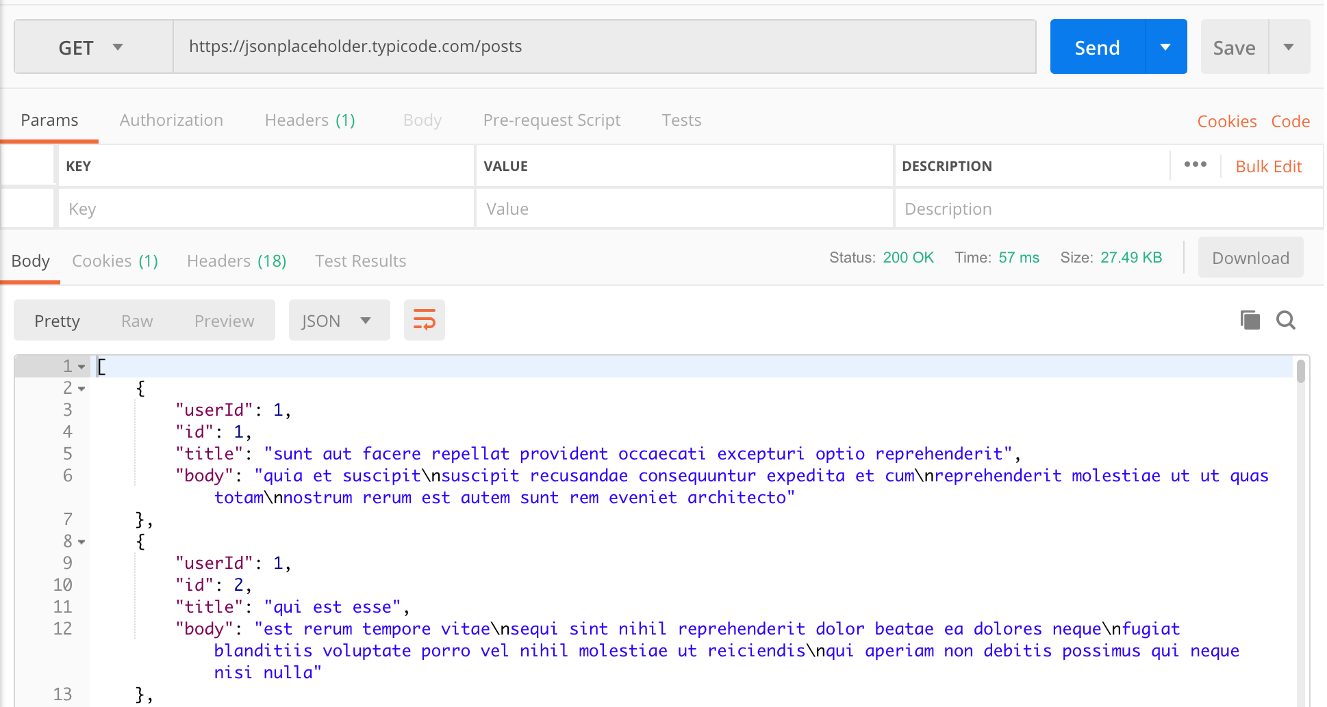
Try REST API
GET: https://jsonplaceholder.typicode.com/posts

Slide 82
Try REST API
POST: https://jsonplaceholder.typicode.com/posts
Header: "Content-type": "application/json"
Body: {
"title": "foo",
"body": "bar",
"userId": 1
}

Slide 83
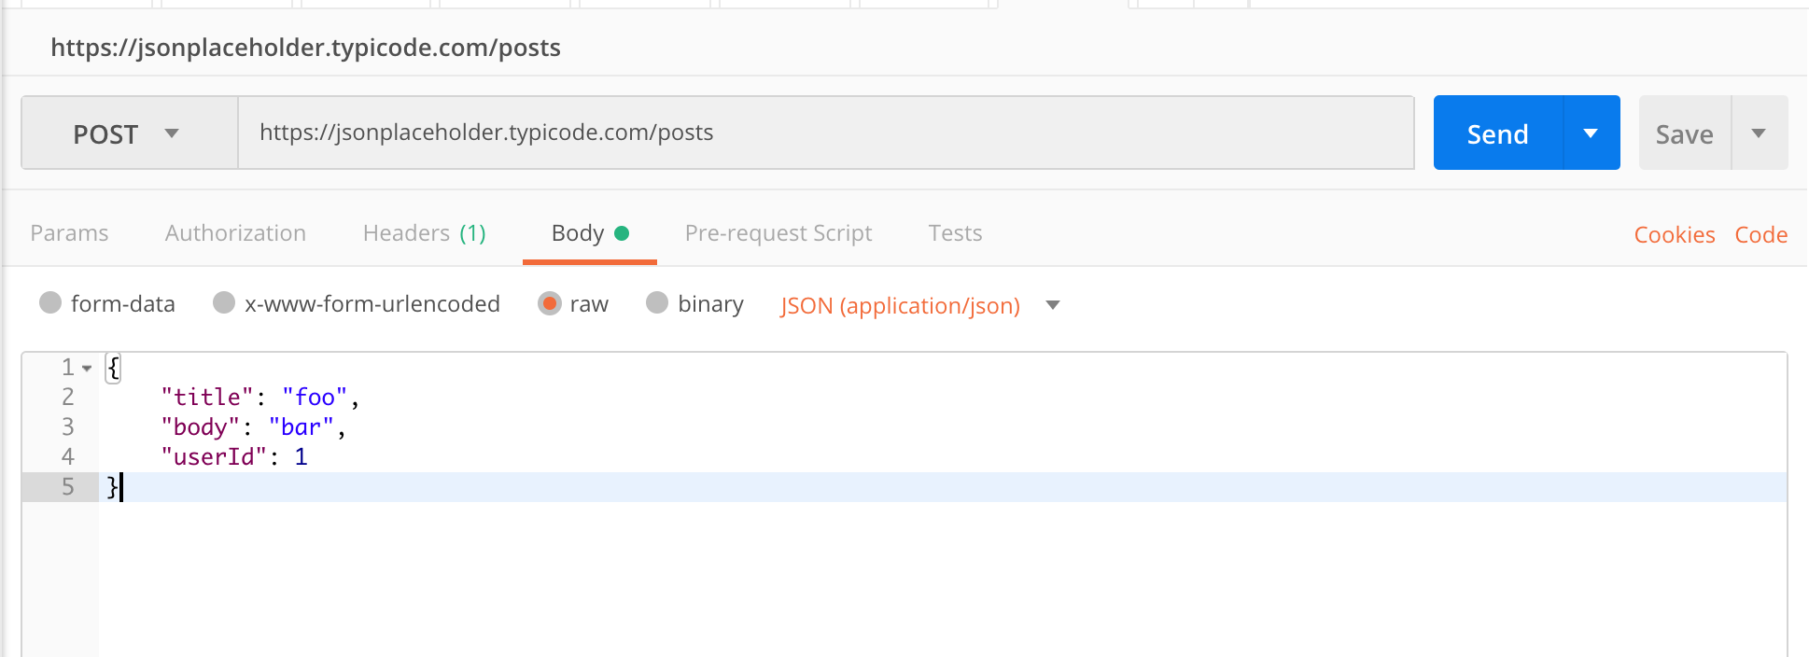
Try REST API (POST)

Slide 84
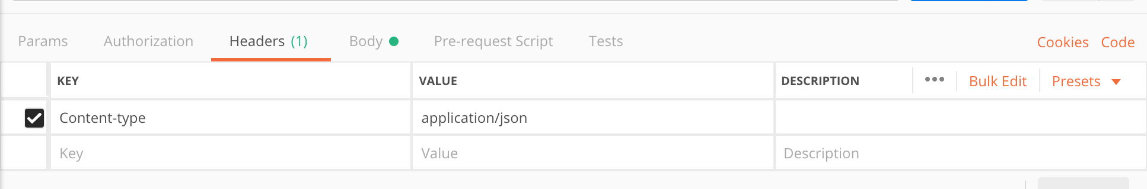
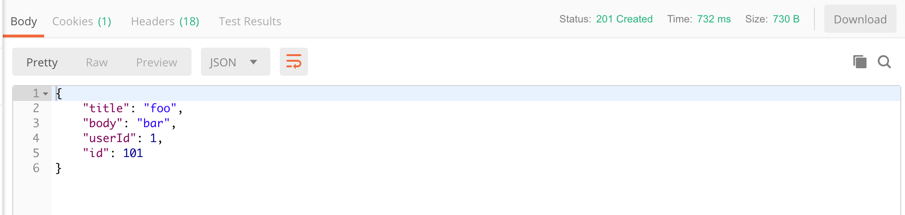
Try REST API (POST)

Slide 85
Try REST API
PUT: https://jsonplaceholder.typicode.com/posts/{id}
Header: "Content-type": "application/json"
Body: {
"Id": 1,
"title": "foo",
"body": "bar",
"userId": 1
}

Slide 86
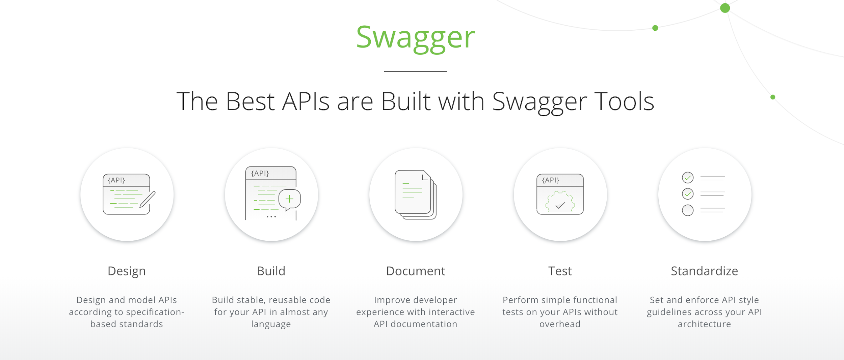
Swagger

Slide 87
Try REST API
PATCH: https://jsonplaceholder.typicode.com/posts/{id}
Header: "Content-type": "application/json"
Body: {
"title": "foo"
}
DELETE: https://jsonplaceholder.typicode.com/posts/{id}

Slide 88
Why Swagger?
Model APIs with Accuracy
Visualize While You Design
Standardize your Design Styles Across Teams

Slide 89
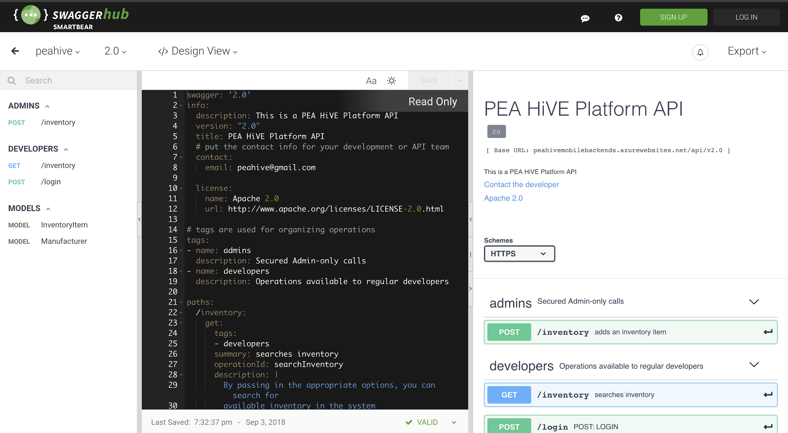
Example

Slide 90
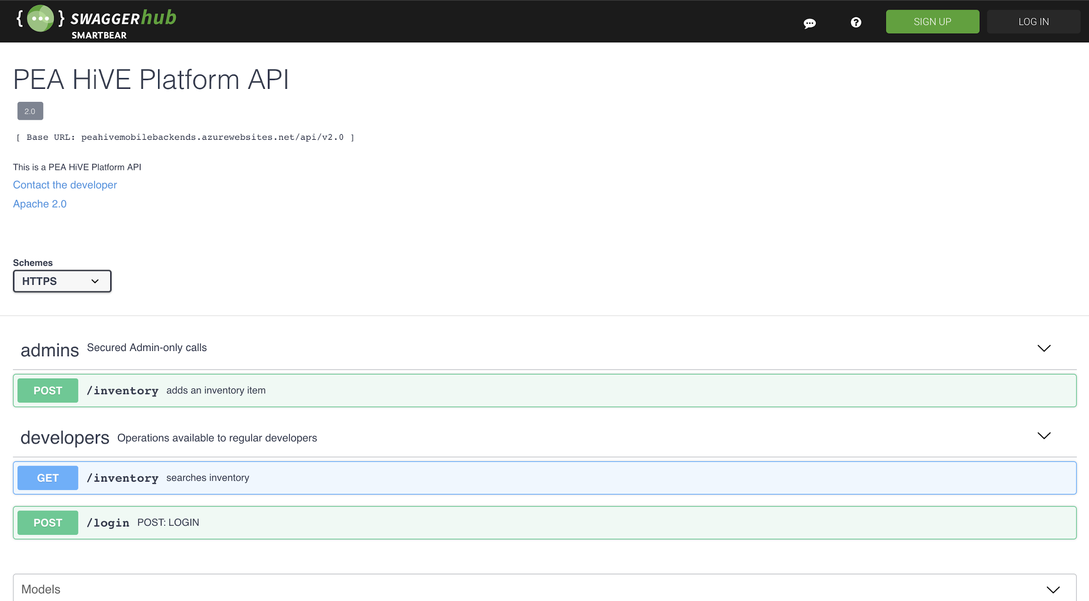
Result

Slide 91
Try Swagger
https://swagger.io

Slide 92
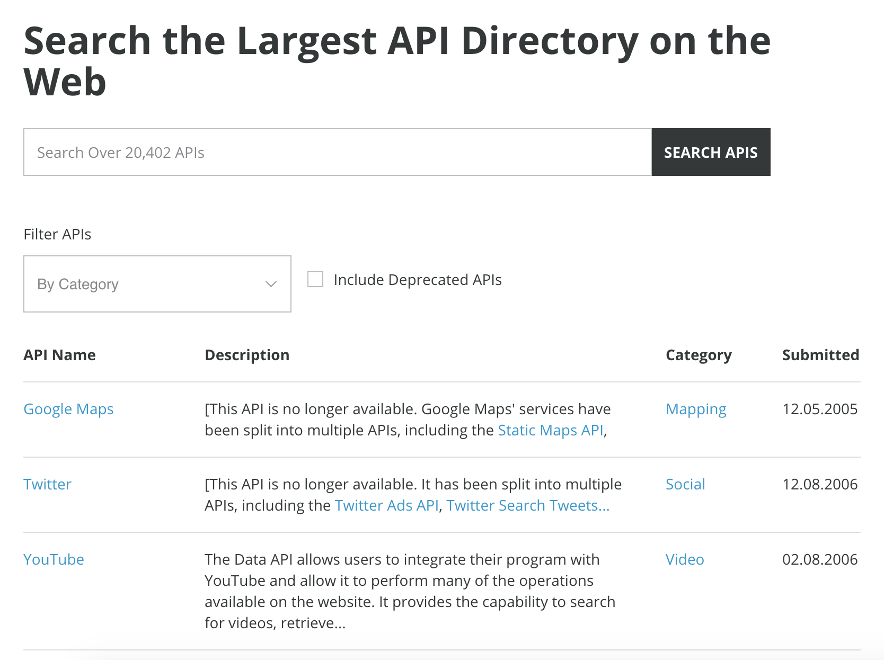
Programmable web
https://www.programmableweb.com/category/all/apis

Slide 93
Web Services
By Altotech

